Slide 1

Spotify and how can we visualize it?
Kamaeva Elina, Ostrovskaya Maria, Sherman Ksenia

Slide 2

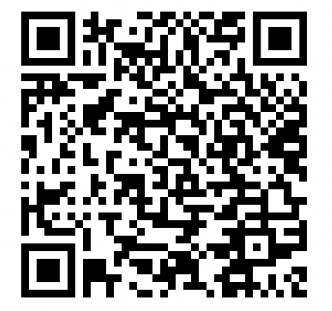
Dataset
Spotify Songs
https://raw.githubusercontent.com/rfordatascience/tidytuesday/master/data/2020/2020-01-21/spotify_songs.csv
Information
Track: id, name, singer, popularity
Album: id, name, release_date
Playlist: id, name, genre, subgenre
Song features: danceability, energy, key, loudness, mode, speechiness, acousticness, instrumentalness, liveness, valence, tempo, duration_ms
QR-code to dataset

Slide 3
Our questions
?
1
On which date are the songs usually released?
2
Is there any correlation between different features of a song?
3
Is there any differences in the number of songs of each genre?
4
Is there any differences in features of songs in different genres?
5
Is there any relation between popularity and features of a song?

Slide 4
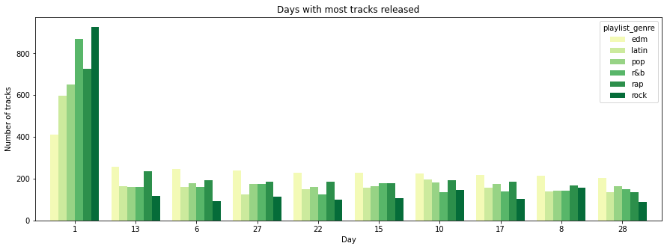
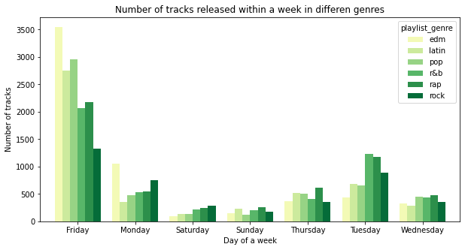
When do songs come out?
Songs of each genre most likely are released on the first day of a month
Friday is a day of new songs

Slide 5
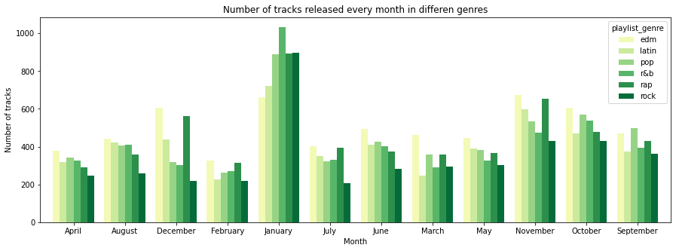
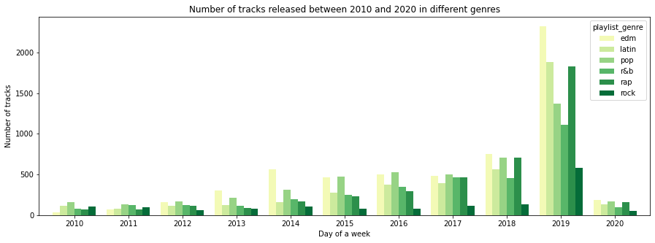
When do songs come out?
Many songs are released in January
2019 is the year of new songs

Slide 6
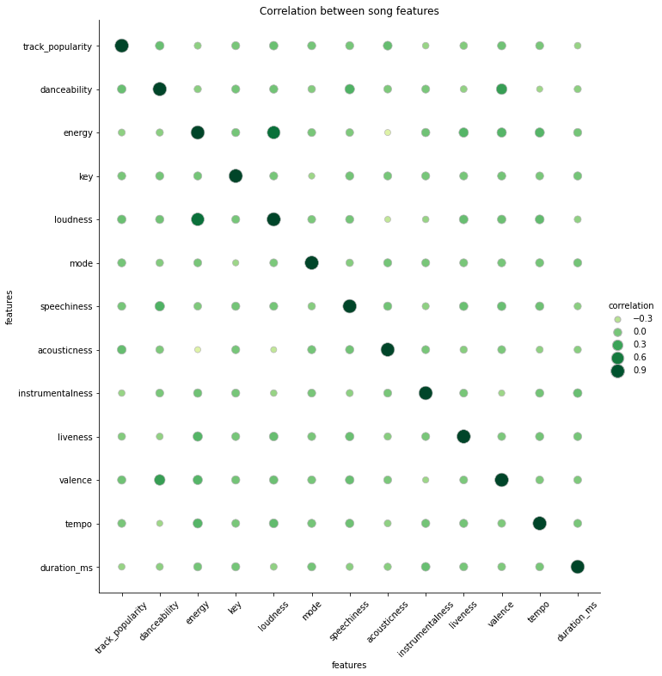
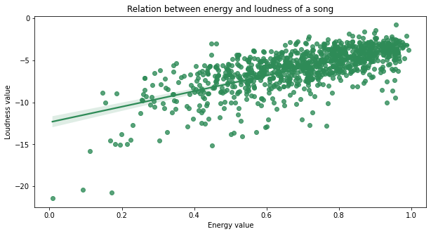
Song features
Only one strong linear relation is found - between energy and loudness
Thought: other characteristics may have a non-linear relationship

Slide 7
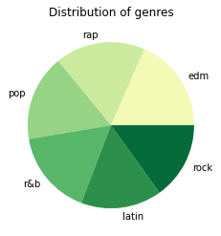

Genres info
The number of songs of each genre is the same

Slide 8
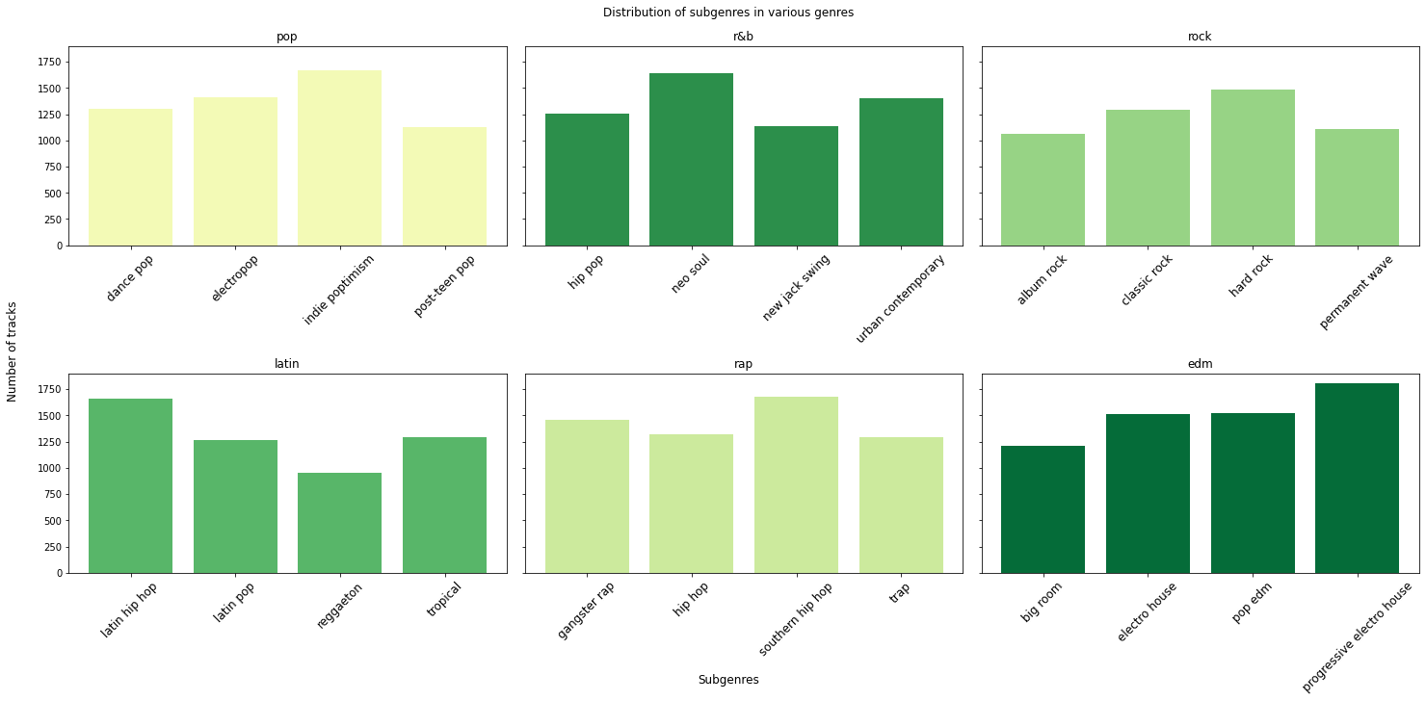
Genres info

Slide 9
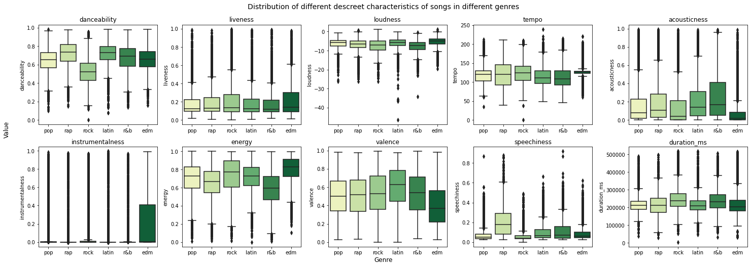
Genres info

Slide 10
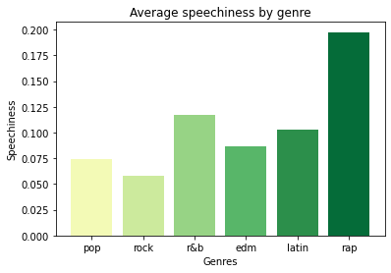
About speechiness
Hypothesis: rap songs have the biggest value of speechiness

Slide 11
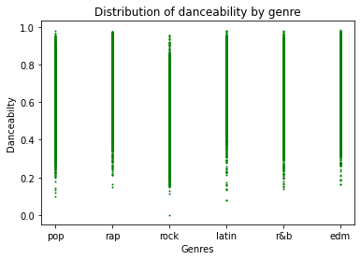
About danceability
Purpose: to understand whether there are genres that consist mostly of the danceable songs

Slide 12
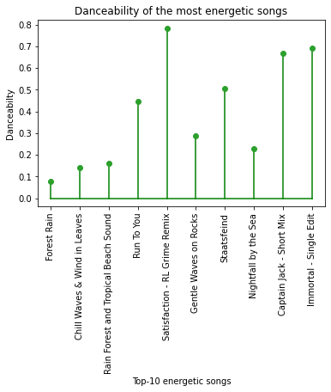
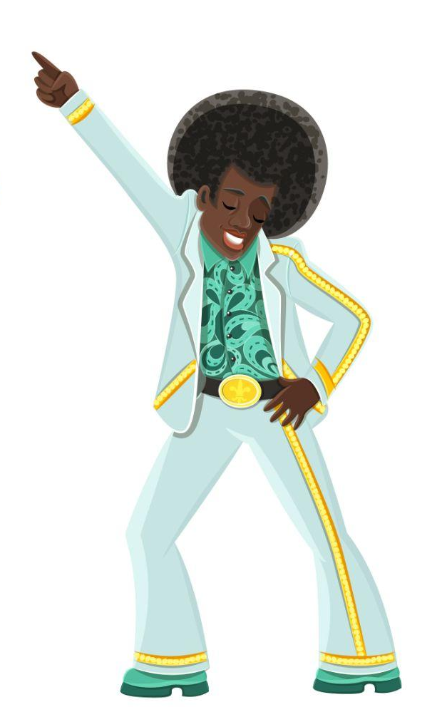
Energy = danceability ?
Hypothesis: the most energetic songs have a big danceability

Slide 13
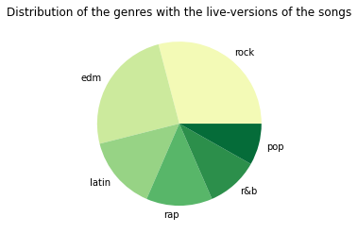
About liveness
Purpose: to understand what genres are most likely to be heard in live-version

Slide 14
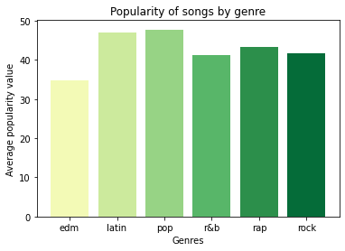
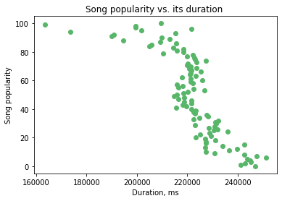
Popularity
Main question: what characteristic influences the popularity of a song the most?

Slide 15
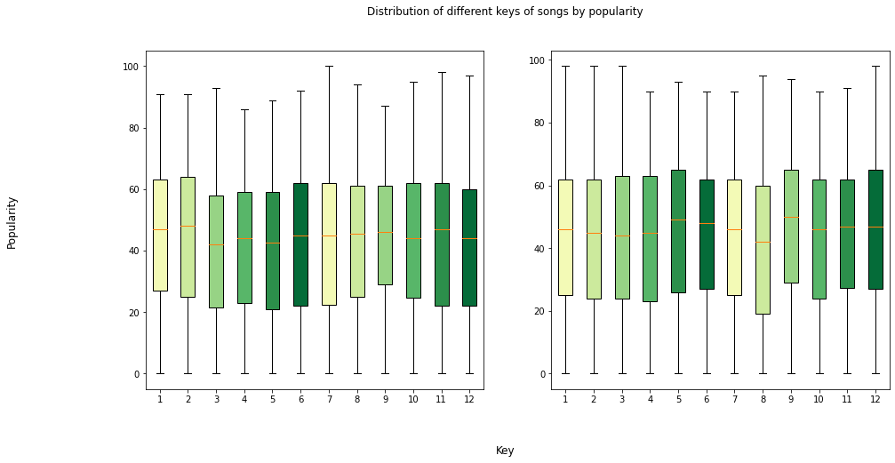
Popularity & keys

Slide 16
Conclusion
1
The number of songs of each genre is the same
!
2
There is a linear relation between loudness and energy
3
The shorter the duration of the song, the more popular it is
4
Songs of each genre most likely are released on the first day of a month, usually on Friday and in January
5
Some genres are distinguished by certain features (e.g. speechiness → rap, liveness → rock/edm )

